Slide 1




Slide 2
Make The Game Yours

Slide 3
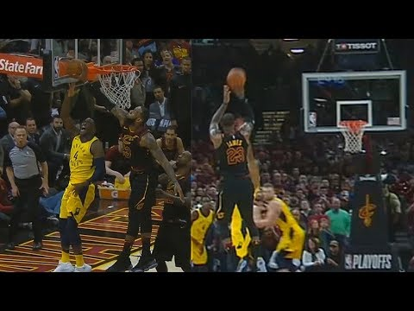







Upload events
Choose your team
WSC Magic
Publish

Slide 4

Spread usage
Advertisement of Associations
Subscribers

